Slide 1
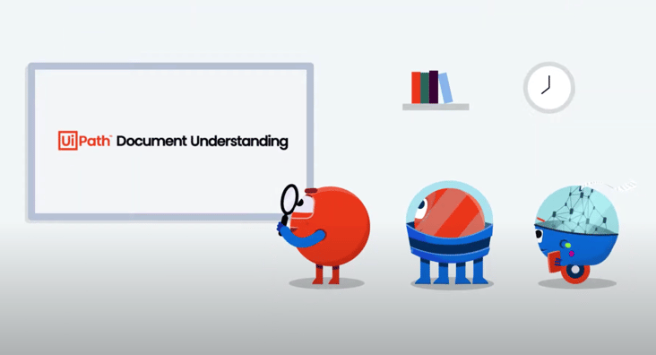
Start
Create and Define Structure
PDF
Taxonomy
Document Understanding Framework
Converting document into digit readable format
Digitize
OCR Engine
Image
Invoice
Classify
Form
Extractor
Receipt
ML
Extractor
Data Extract
Extractor
Intelligent Form
Extractor
Present Validate
Ensure the data Capture correctly
Intelligent Form
Extractor
End
Export data

